Slide 1
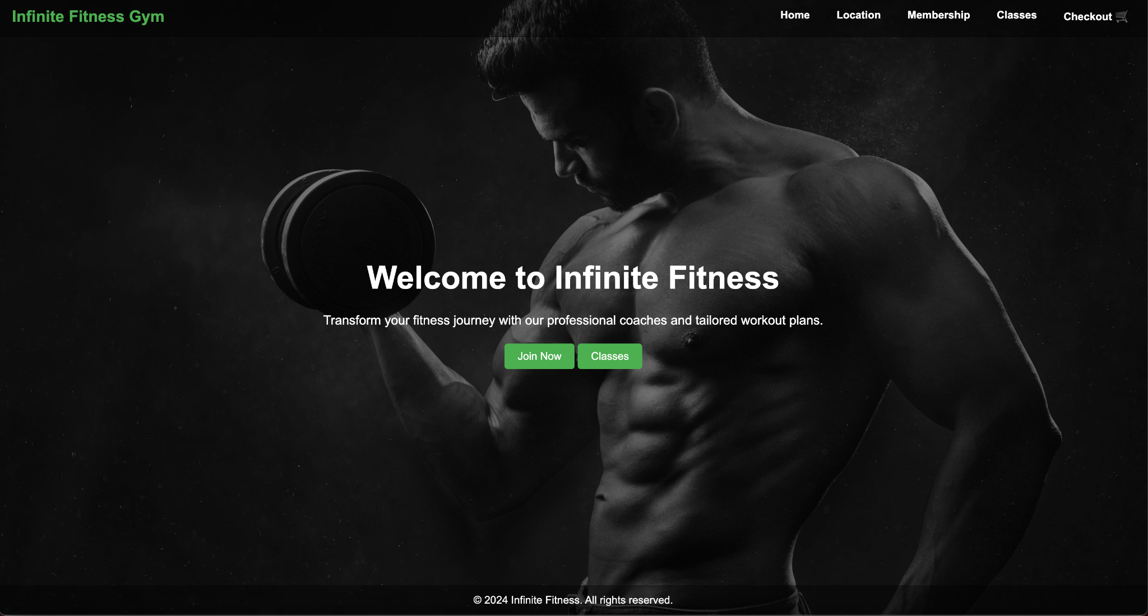
Gym Site:
12/16/2024
Daniel Rivas

Slide 2
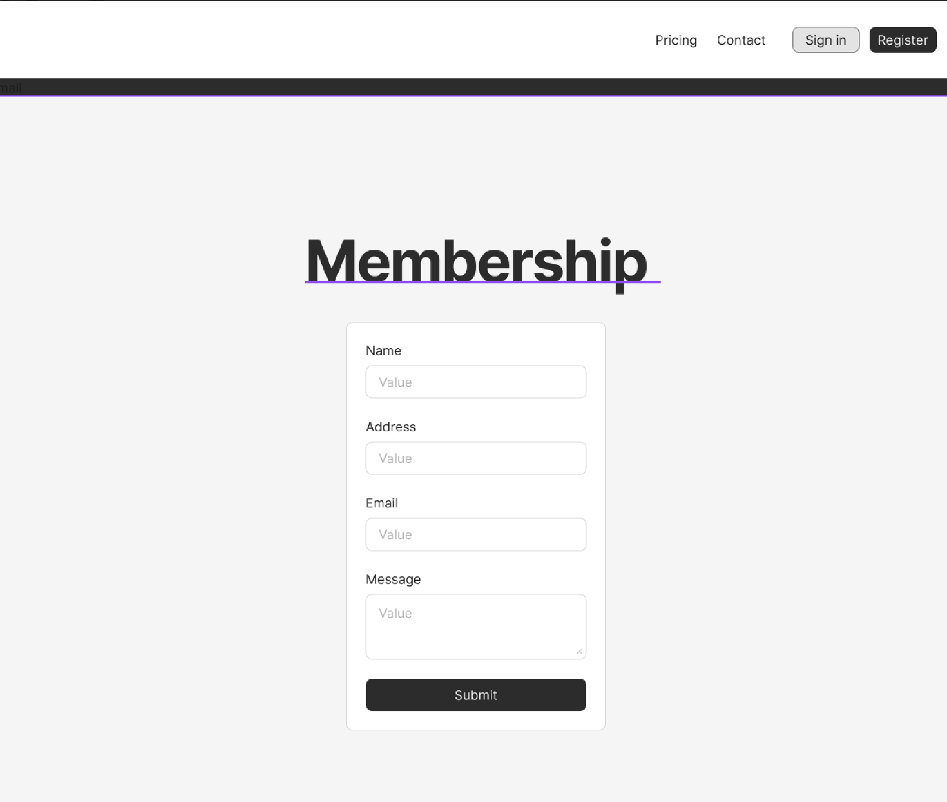
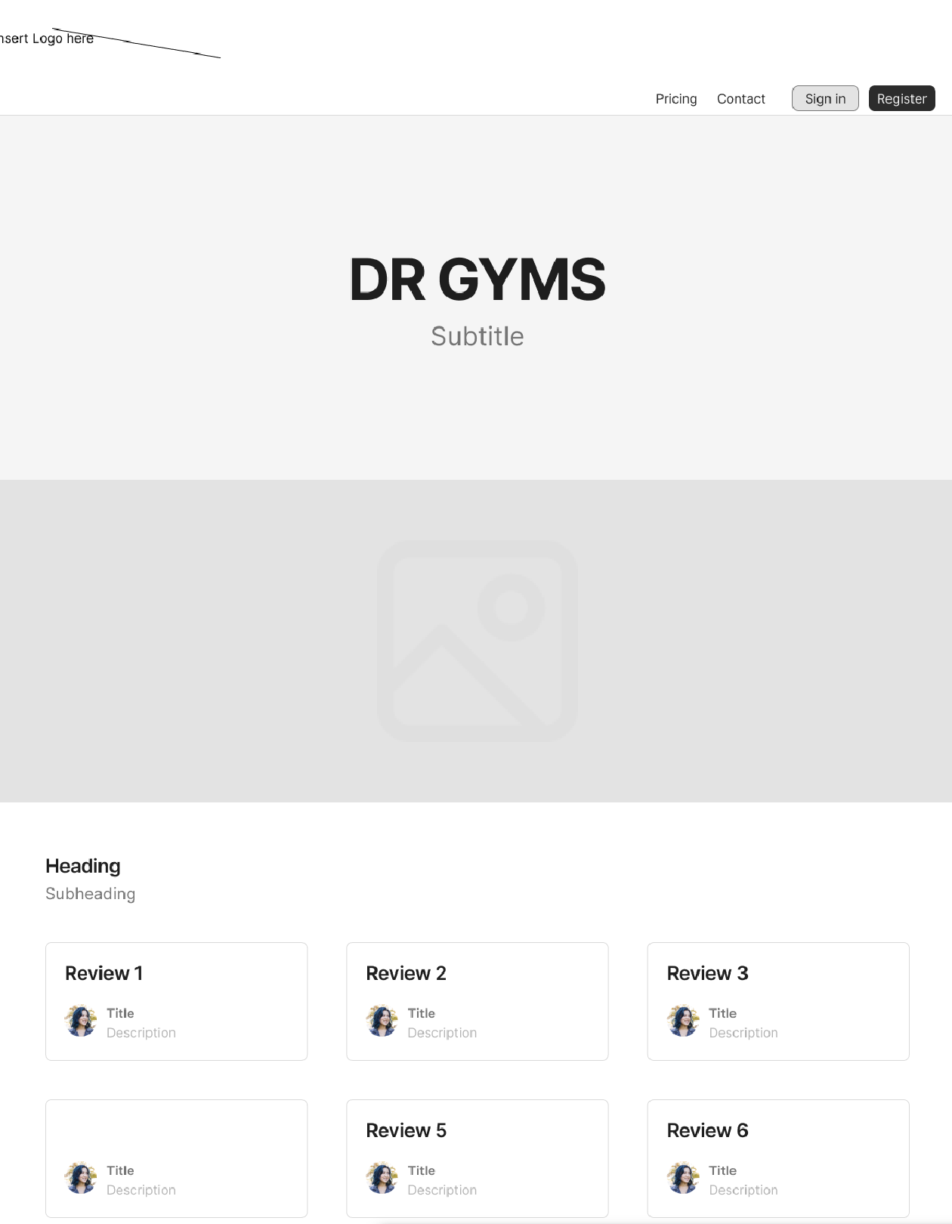
Wireframe:
Whilst in early development this was a mockup of how the site was going to look
Date
School Name

Slide 3
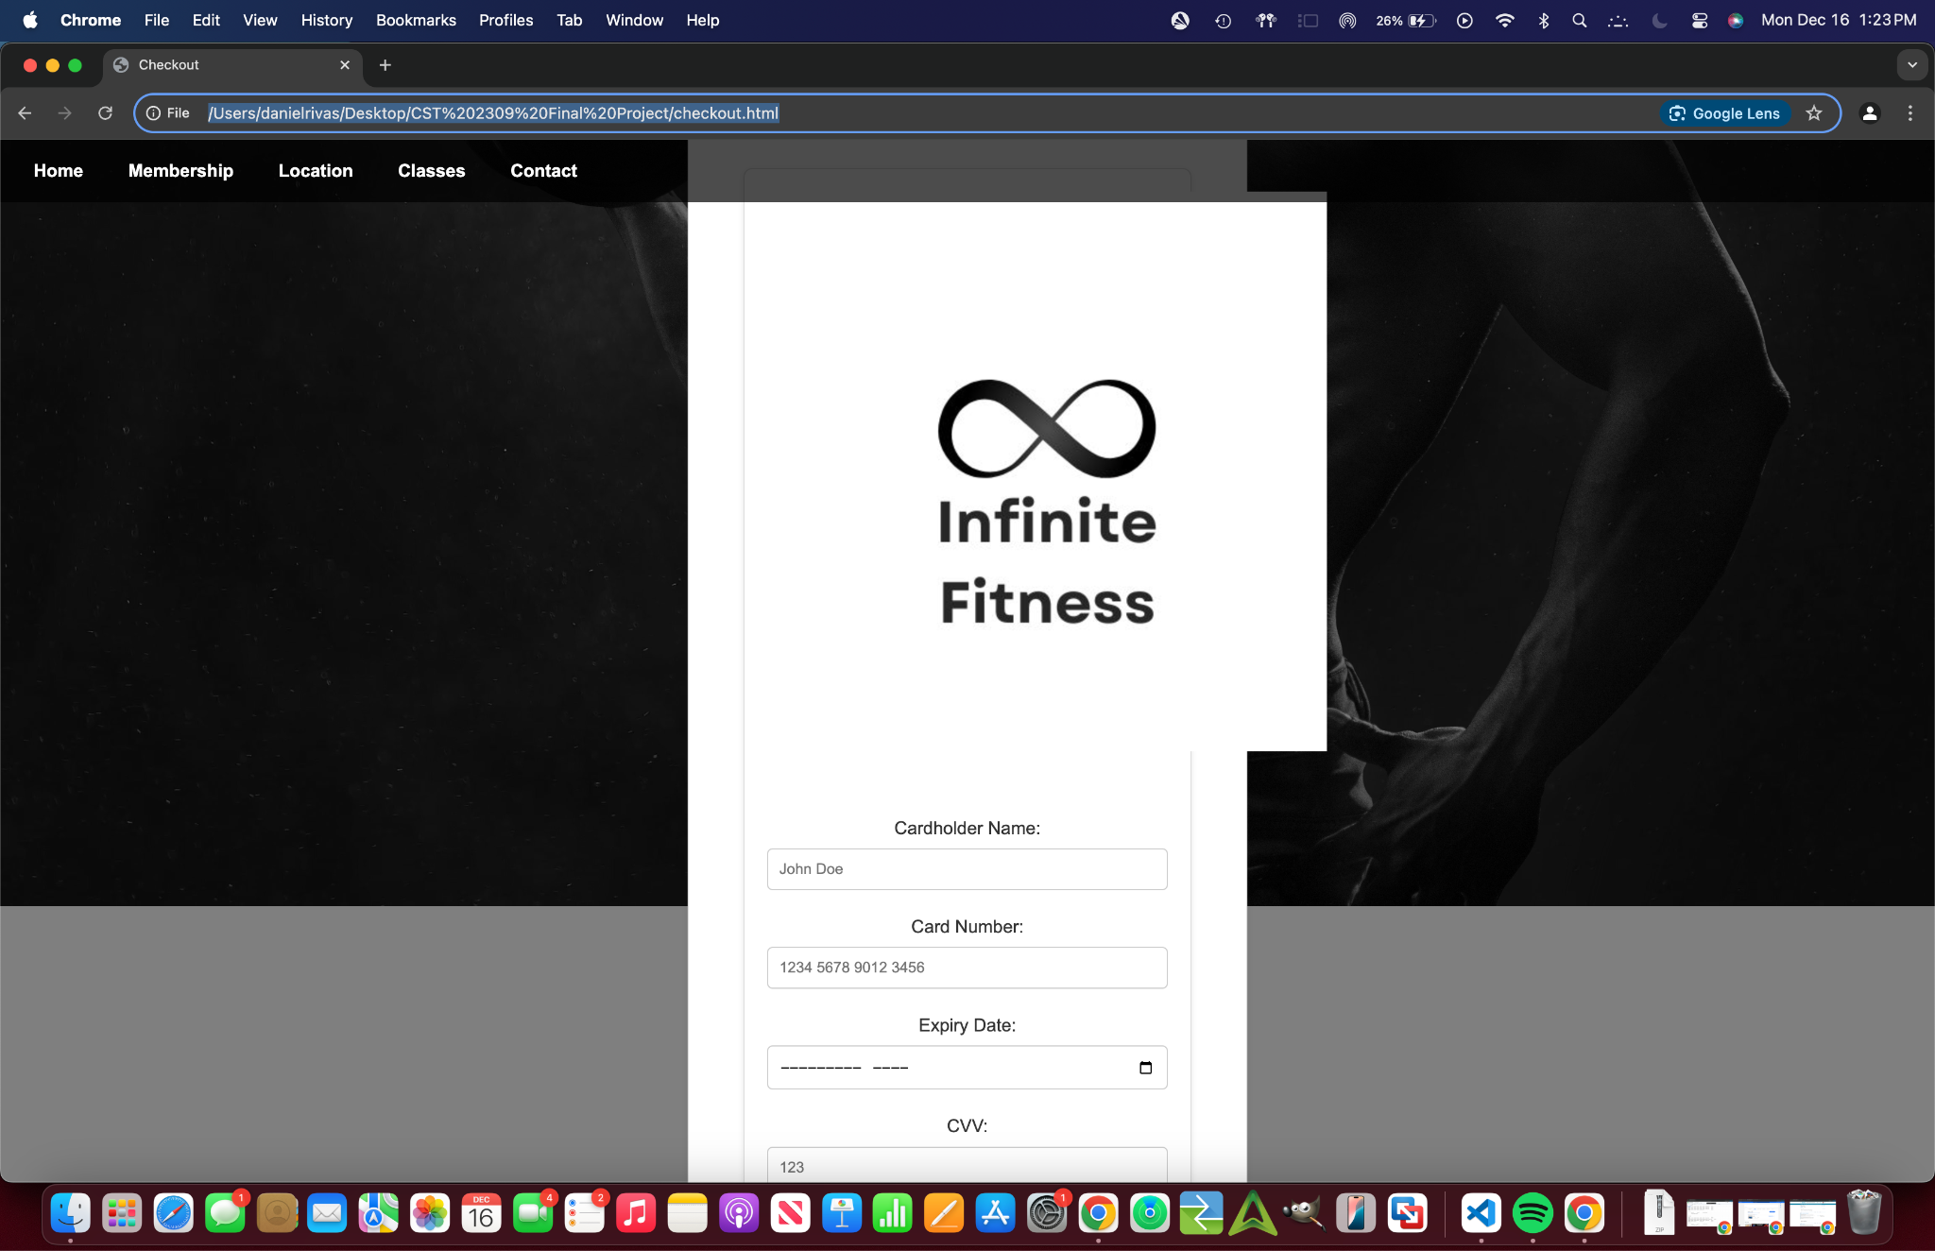
Troubleshooting
Per the usual images not scaling properly
Clashing of Css styles and priorities

Slide 4
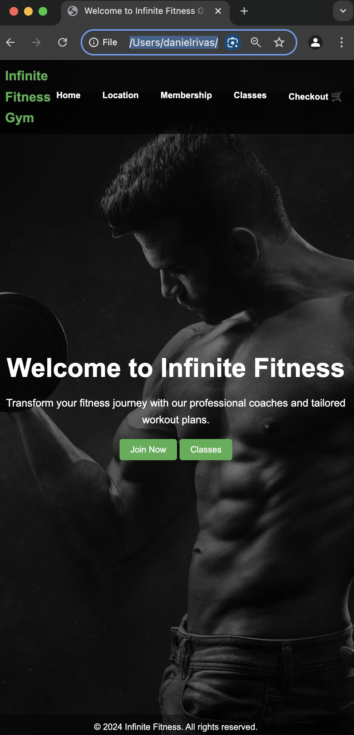
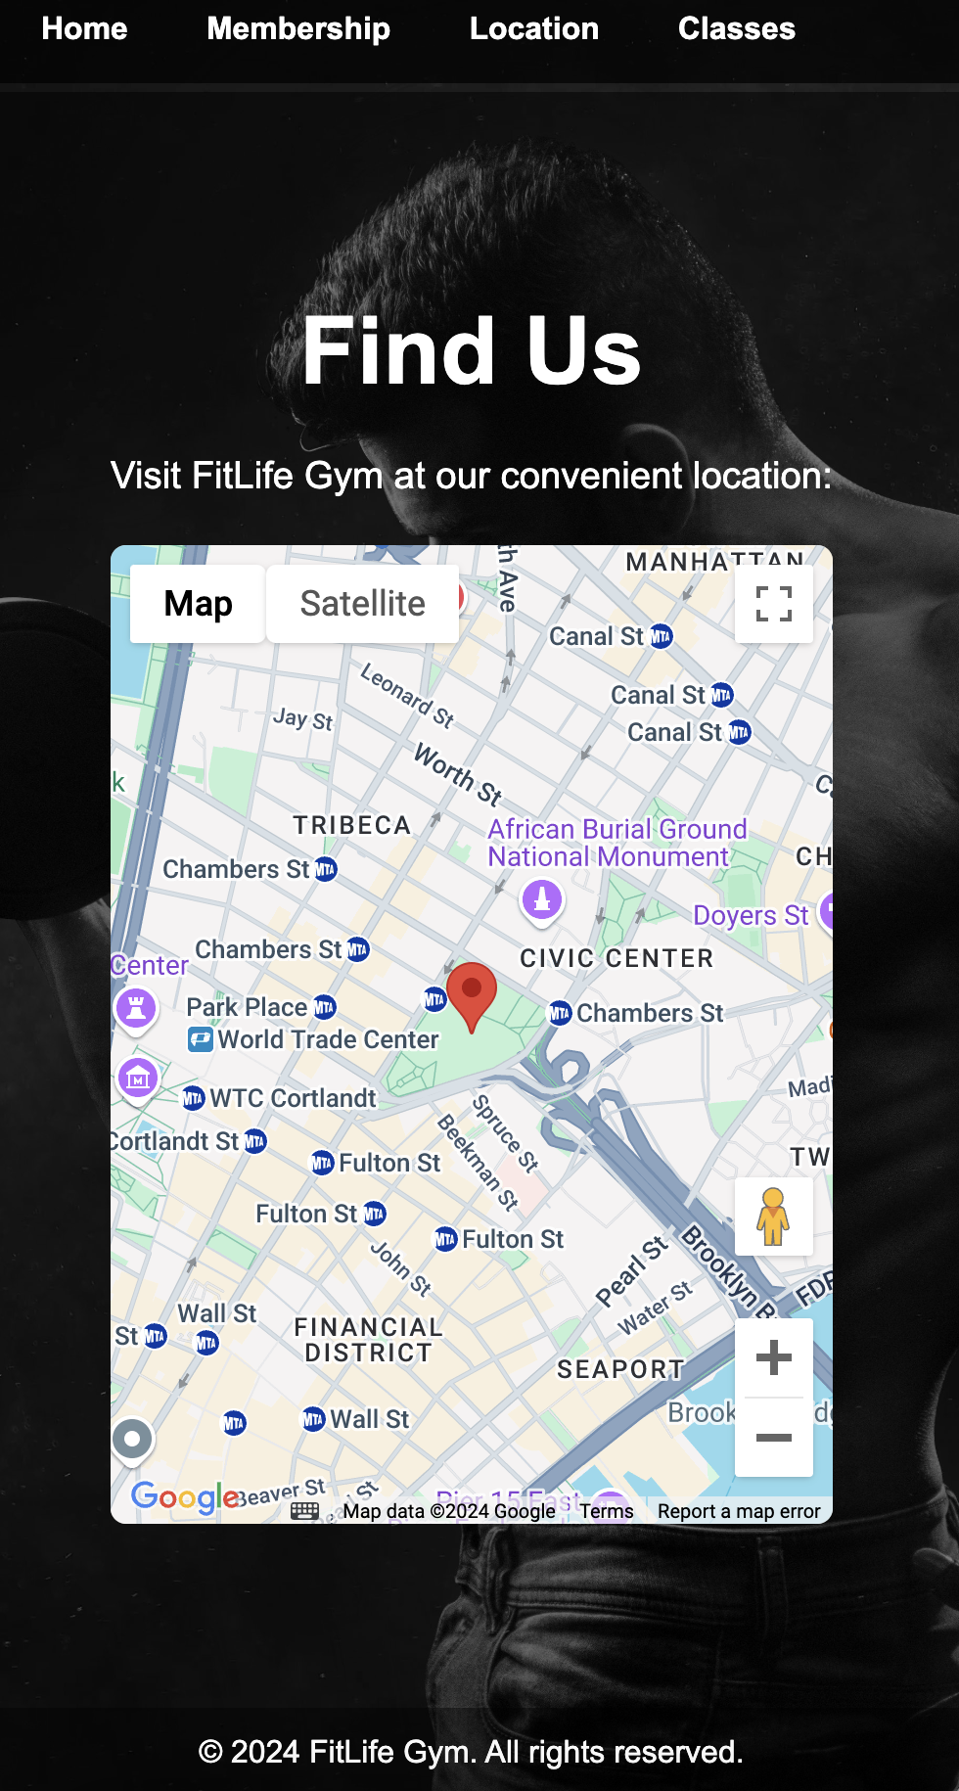
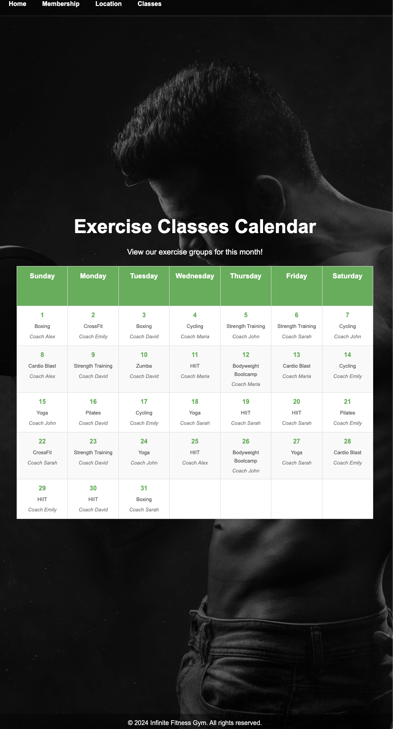
Homepage
Location
Calendar

Slide 5
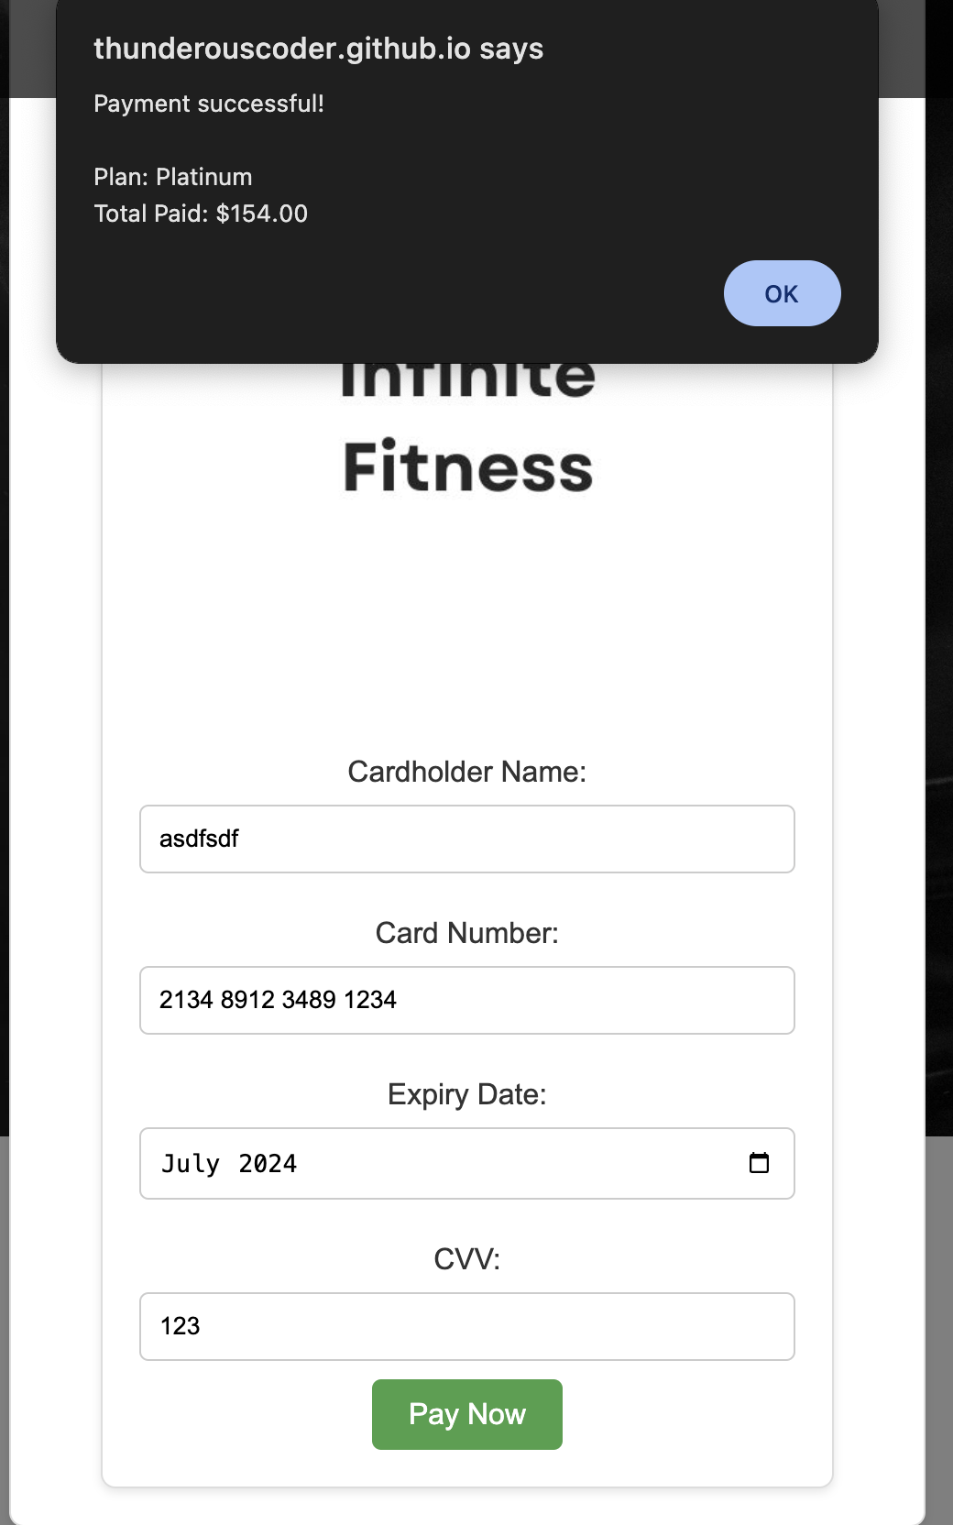
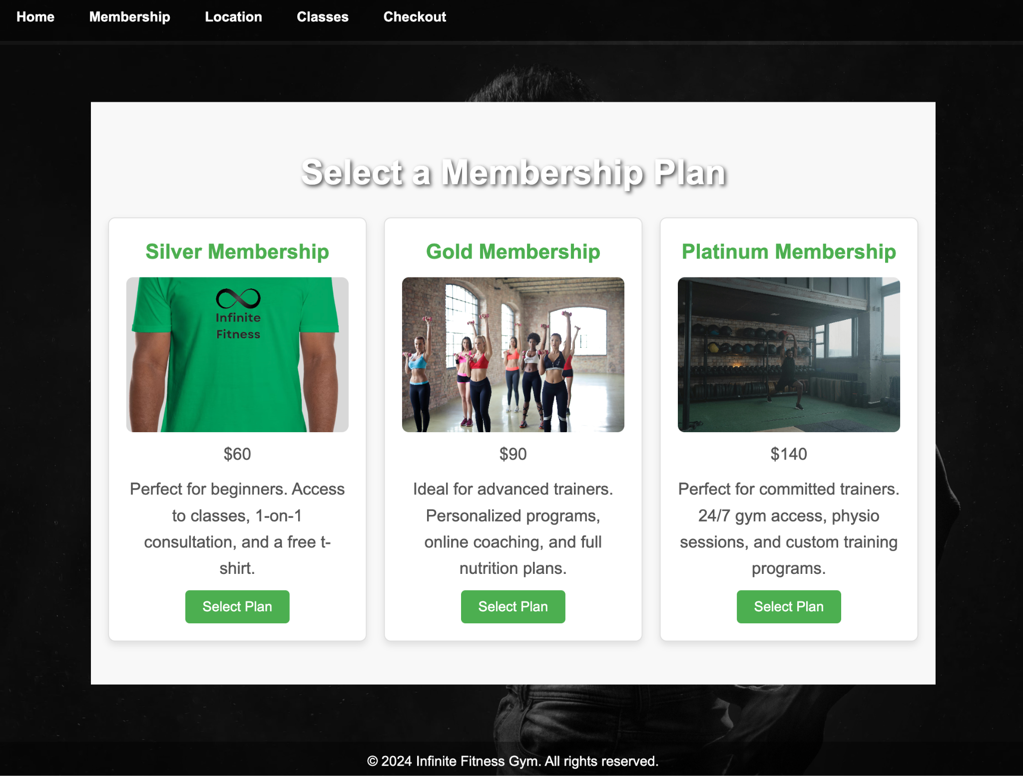
Final stages

Slide 6

References/Resources
https://www.youtube.com/watch?v=BT4WzyT2g8k
https://www.pexels.com/search/gym%20atmosphere/
https://www.canva.com/
Date
School Name

